Slide 1
Learning Binary Code for Personalized Fashion Recommendation
CVPR 2019

Slide 2
Motivation
Item和outfit经济地存储
不仅准确而且有效的评估outfit的搭配度
最搭配的item和outfit需要被迅速地检索
Hash技术，学习二值码，efficient personalized fashion outfit recommendation

Slide 3
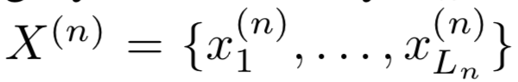
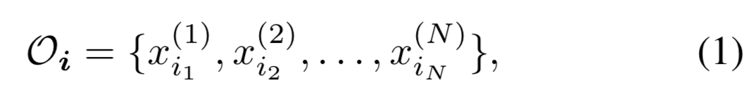
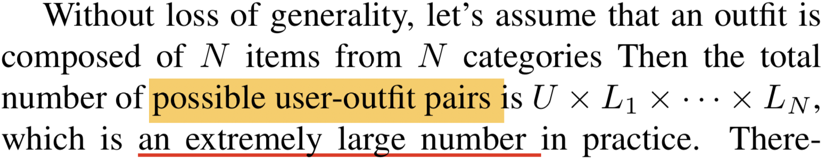
Problem formulation
N个类别
Ln: 第n个类别的item数量
U：users数量
第N个类别的所有items
一个outfit：N个items
某个用户的个性化时尚偏好可以用该用户过去创建或评价的outfit来隐式表示。
Task：predict r_{u,Oi} for any user and outfit pair

Slide 4
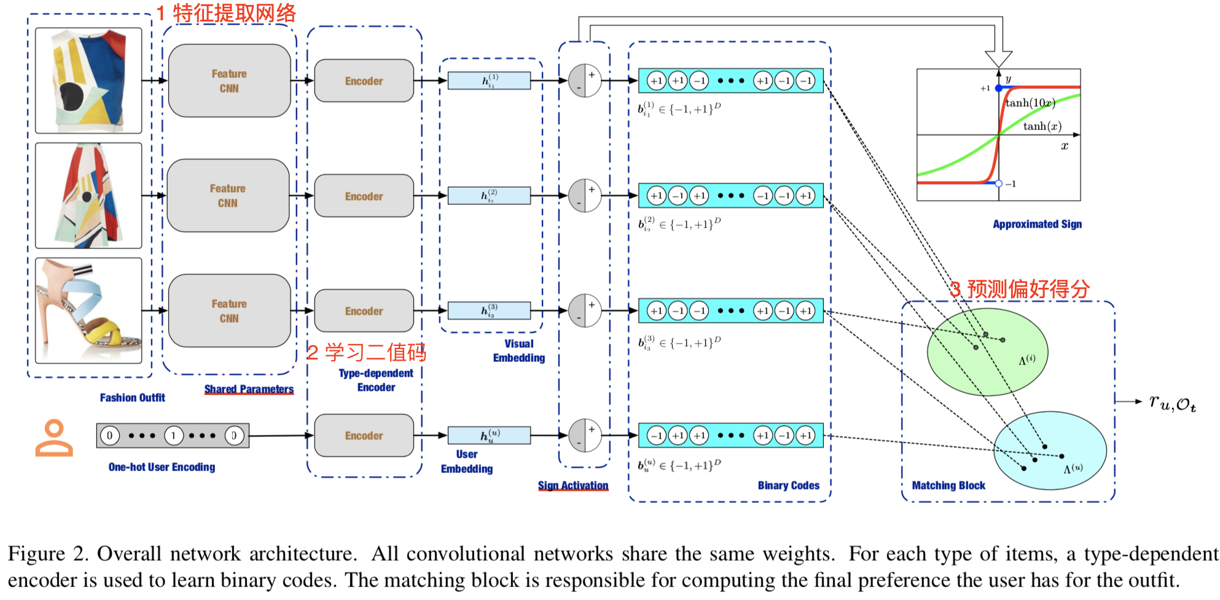
Overall framework

Slide 5
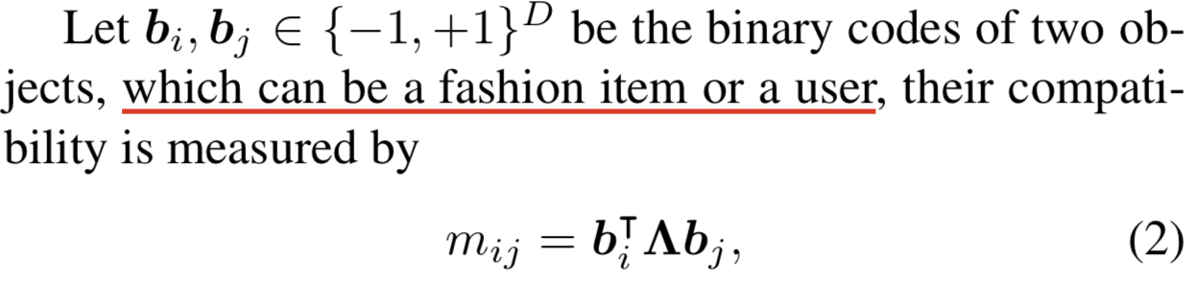
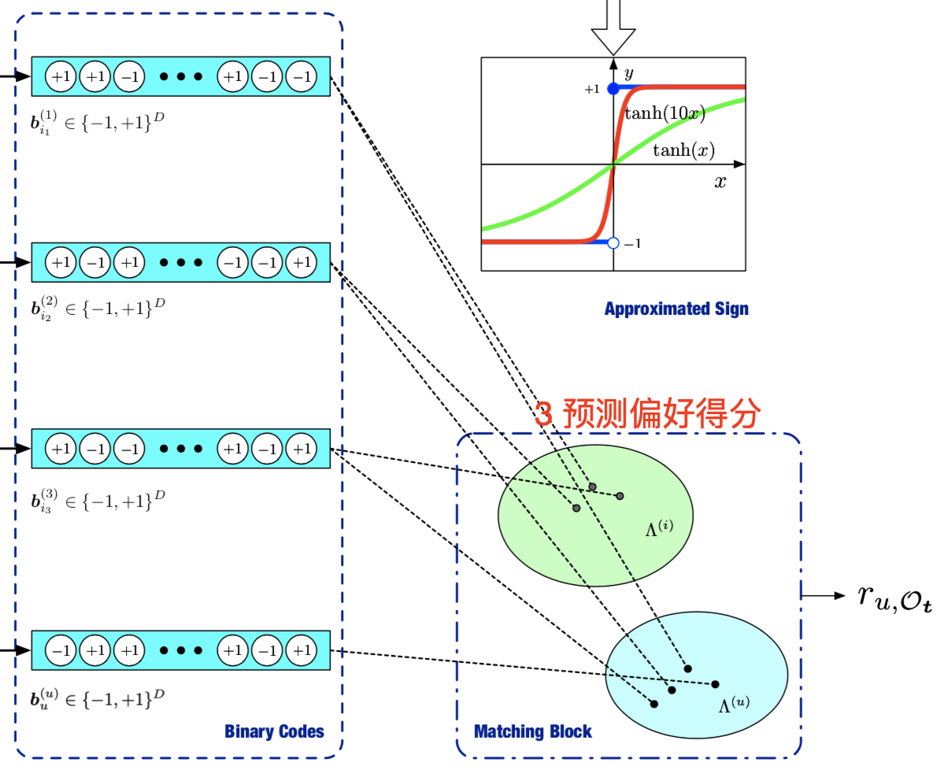
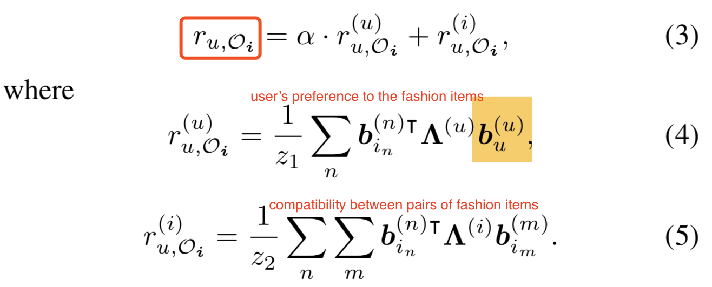
The matching block

Slide 6
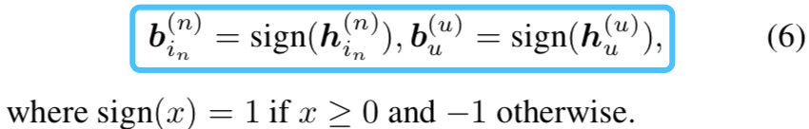
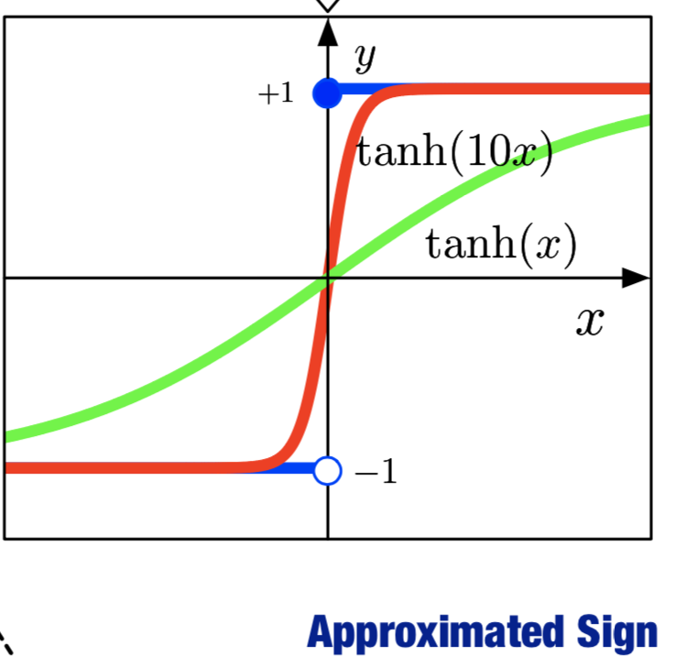
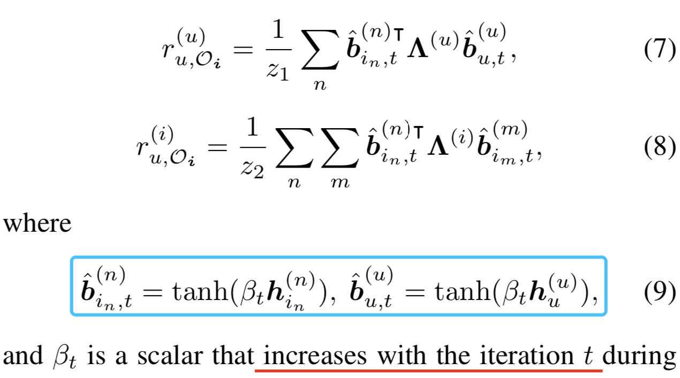
Learn to hash
参考HashNet方法，重写 Eq. (4) 、 Eq. (5)

Slide 7
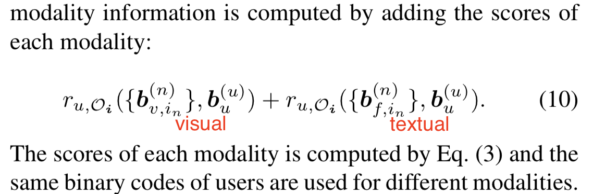
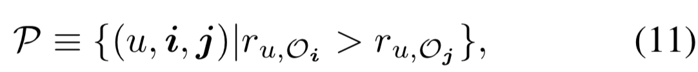
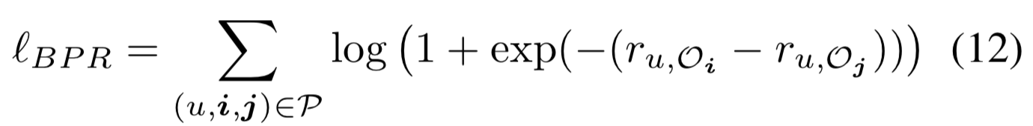
Objective function

Slide 8
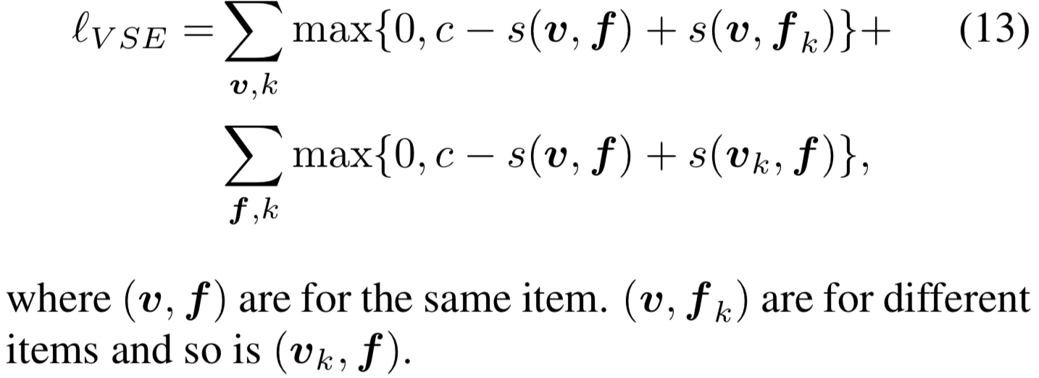
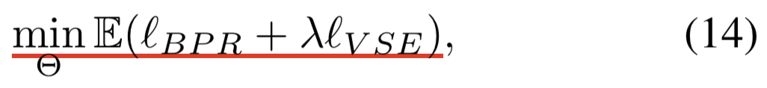
Objective function

Slide 9
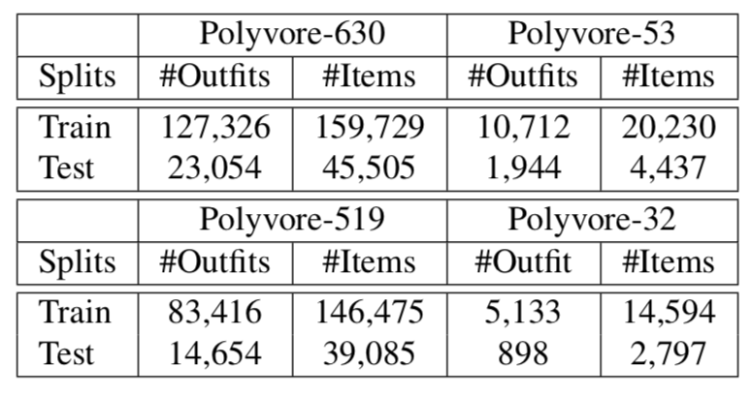
Dataset
Polvvore-630 and Polyvore-53: 固定items数量的outfits
Polvvore-519 and Polyvore-32 ：每个outfit的item数量是不同的
正样本：created by a user
负样本：1 random mixtures of items； 2 random samples of other users’ positive outfits
比率：1：10 for each user

Slide 10
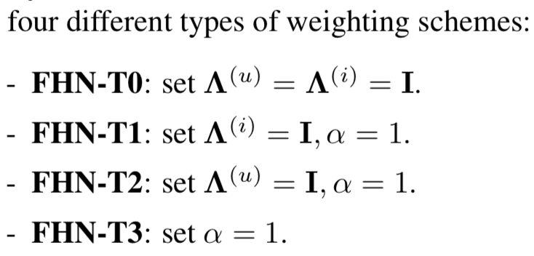
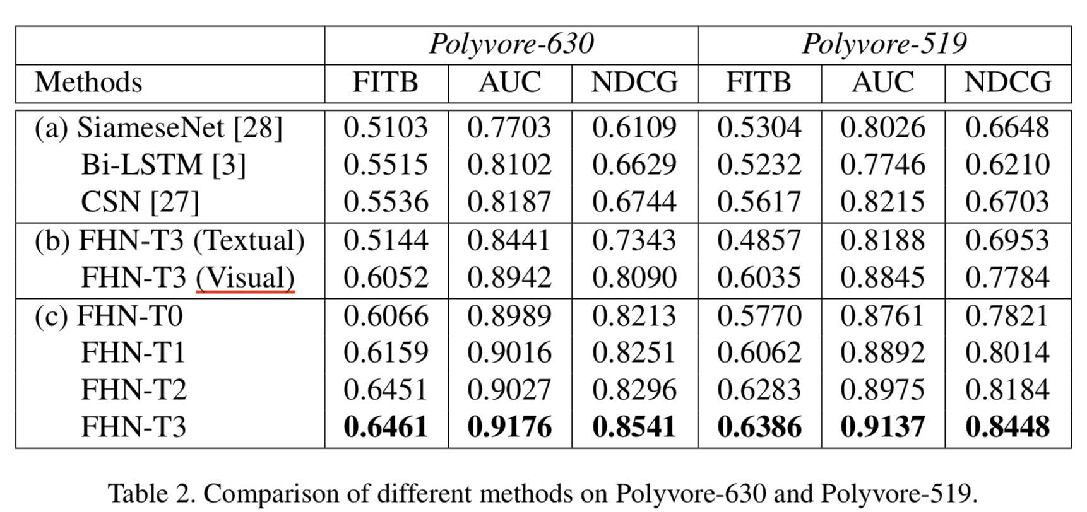
Experiment
adding weighting to hashing

Slide 11
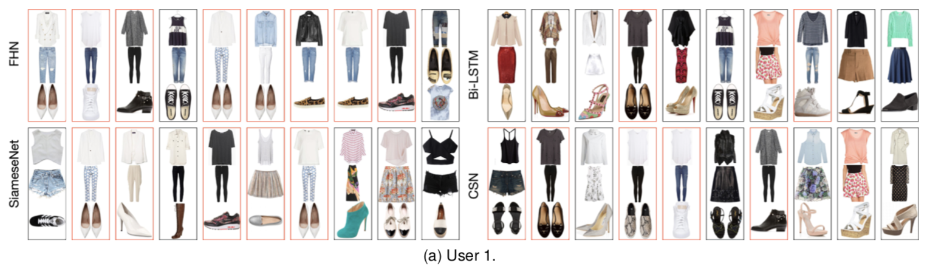
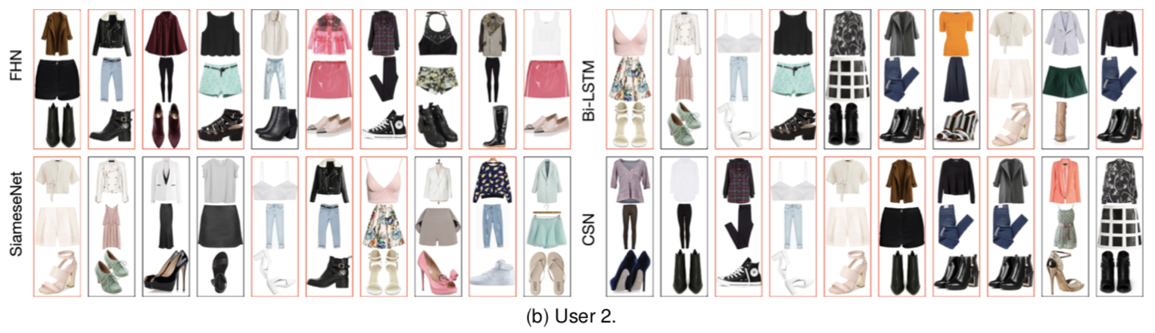
Experiment

Slide 12
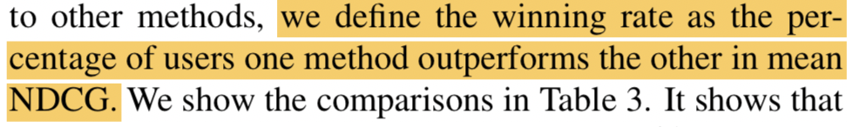
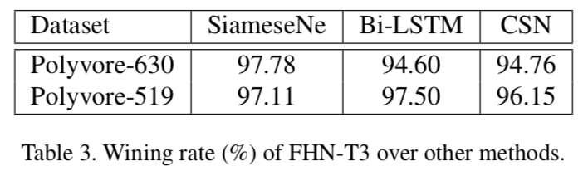
Experiment
personalized modeling of users’ fashion preferences
the BPR optimization : explicitly takes ranking into consideration

Slide 13
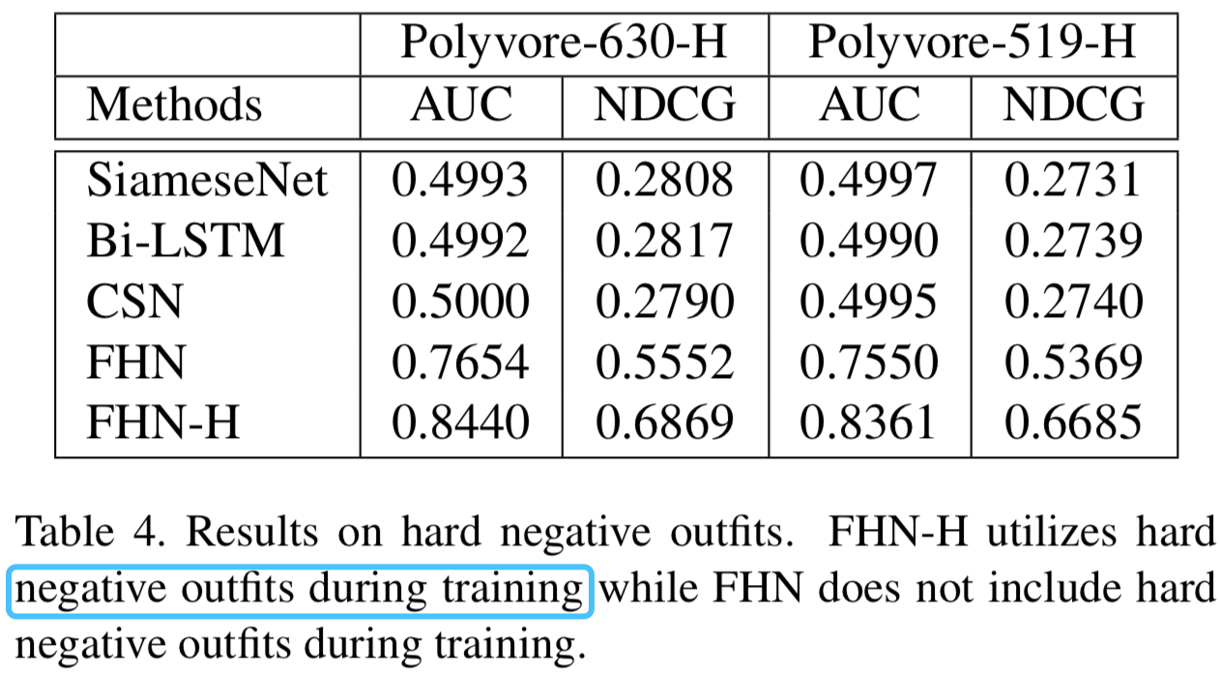
Performance on hard outfits
在以前的工作中，所有用户创建的outfit都被视为正样本。

Slide 14
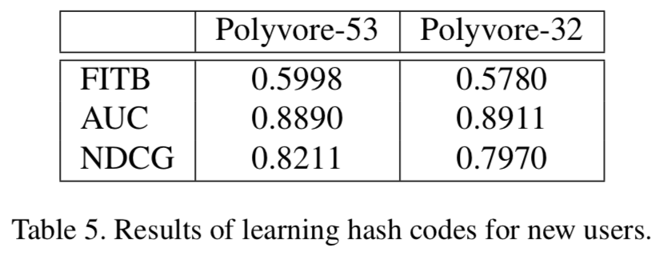
Learning hashing codes for cold-start users
keep the feature network for items fixed.
only retrain the user representations for newcomers, which is only a 128 bits binary code.
have built a model for 630/529 users in the past, and 53/32 new users come.
Dataset has grown around 7%

Slide 15
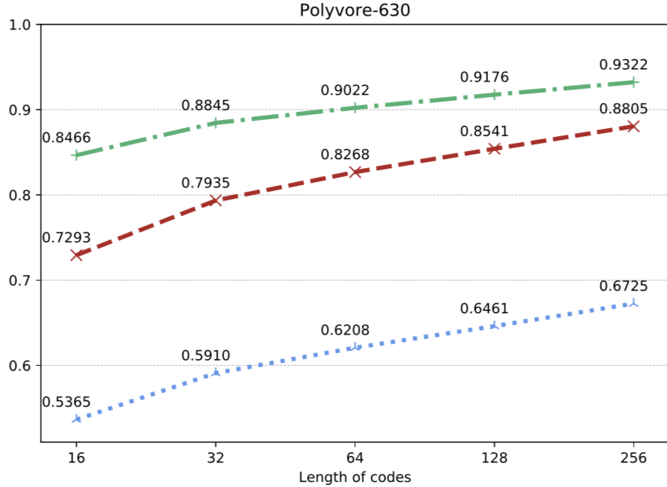
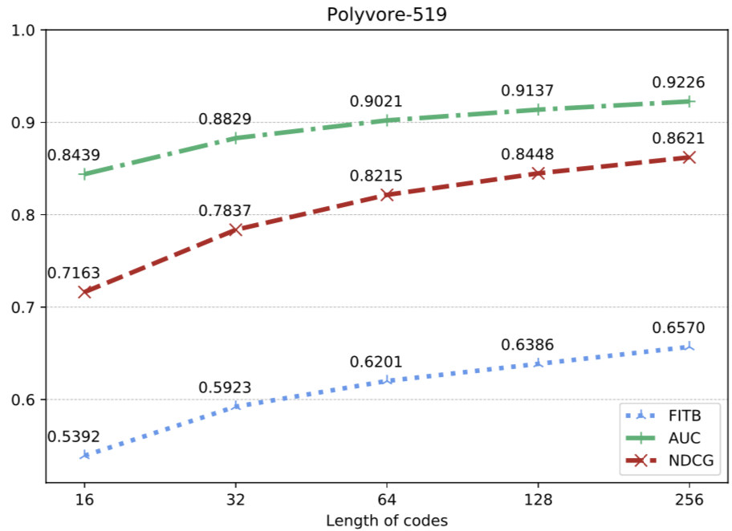
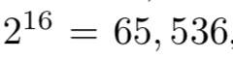
Performance with different lengths of codes

Slide 16
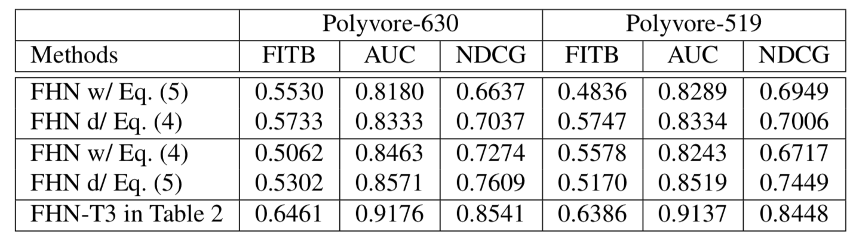
Ablation analysis

